Slide 1
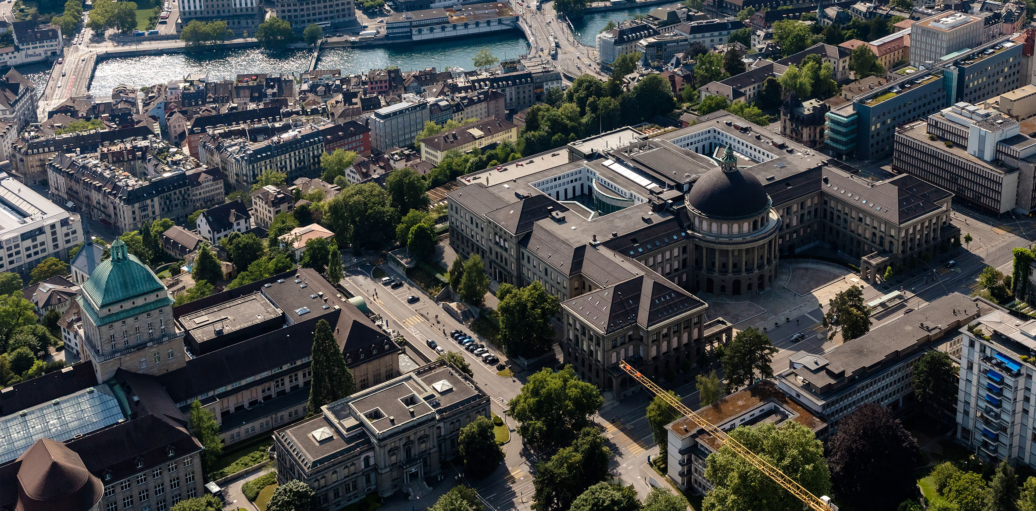

Natural gas v alternative routes for production of chemicals in 2022
Institute for Chemical and Bioengineering
Sustainable Process Systems Engineering Lab
Abhinandan Nabera
06. October 2022

Slide 2
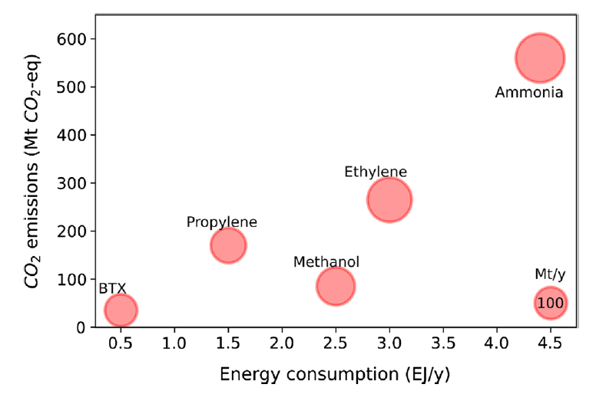
Ammonia and methanol are the most energy intensive chemicals

Slide 3
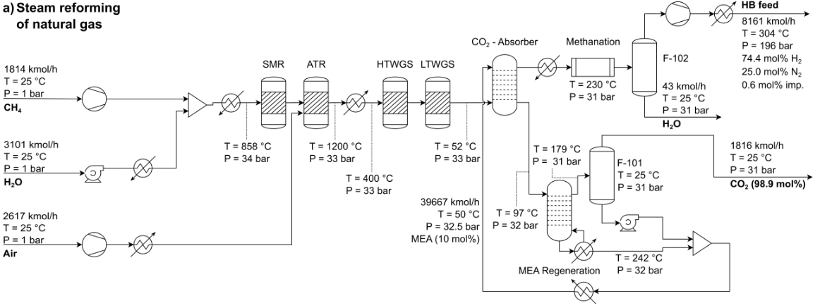
SMR and WGS for the production of conventional hydrogen

Slide 4
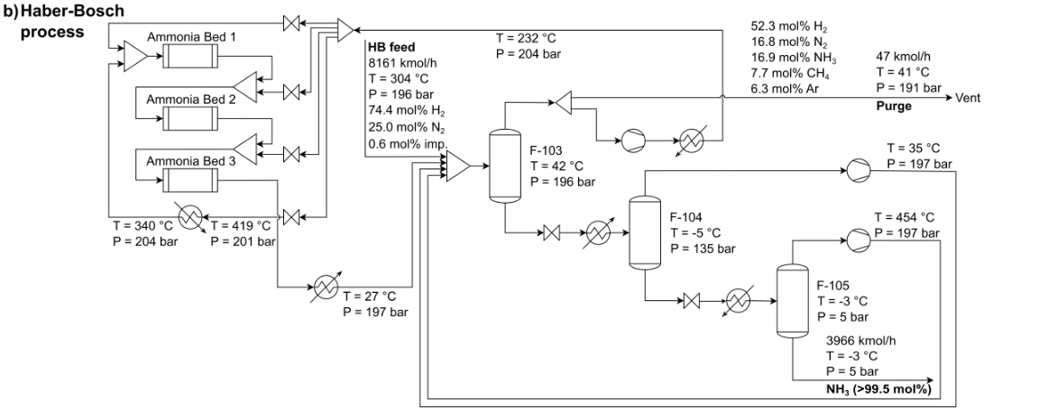
Haber Bosch process for the production of ammonia
Can use hydrogen from electrolysis i.e., green hydrogen

Slide 5
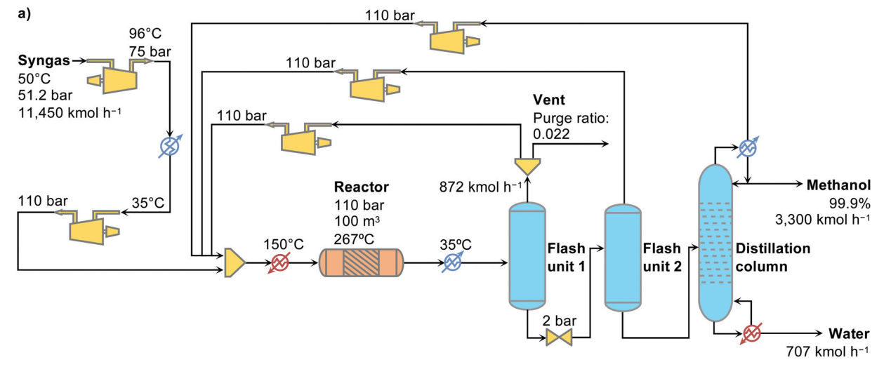
Conventional process for methanol production

Slide 6
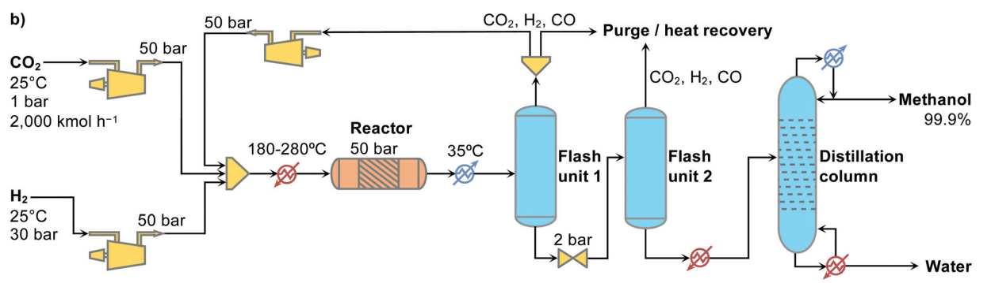
Green alternative for methanol production

Slide 7
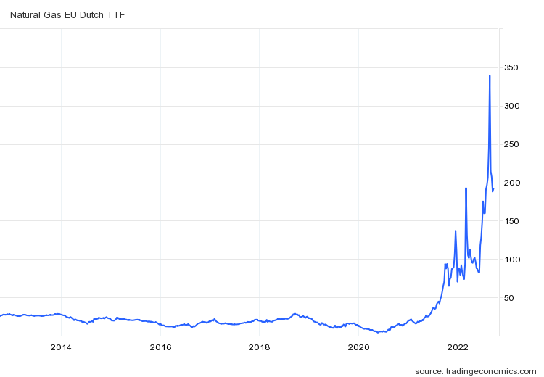
Natural gas prices – current scenario in EUR/MWh
Currently, natural gas prices are five times the average of 2021 (40 EUR/MWh).
It reached a high price of 345 EUR/MWh in 2022.
Green routes v conventional routes.
For NG, 1 EUR/MWh = 13.1 EUR/t

Slide 8
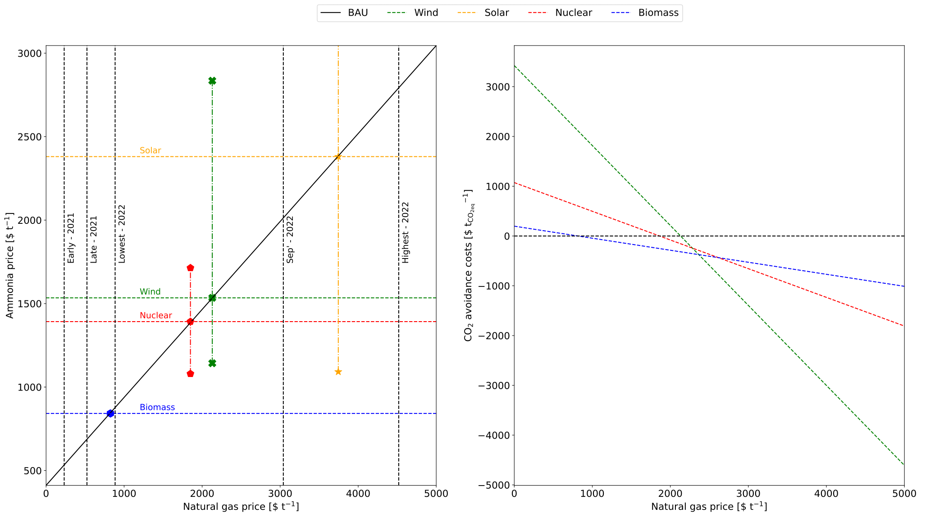

Slide 9
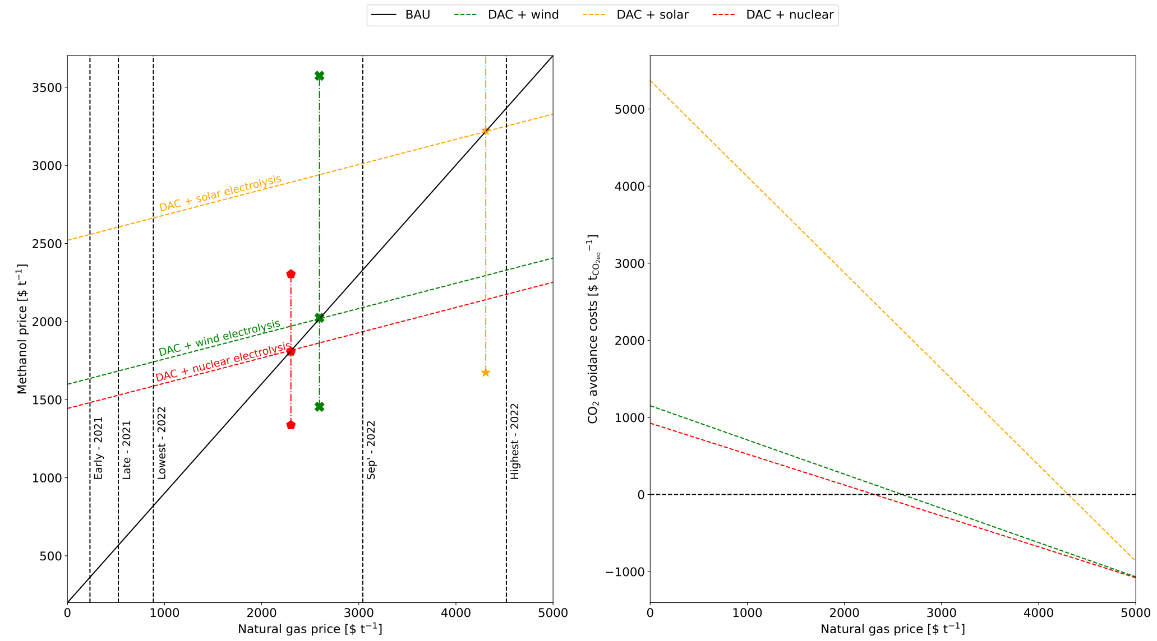

Slide 10
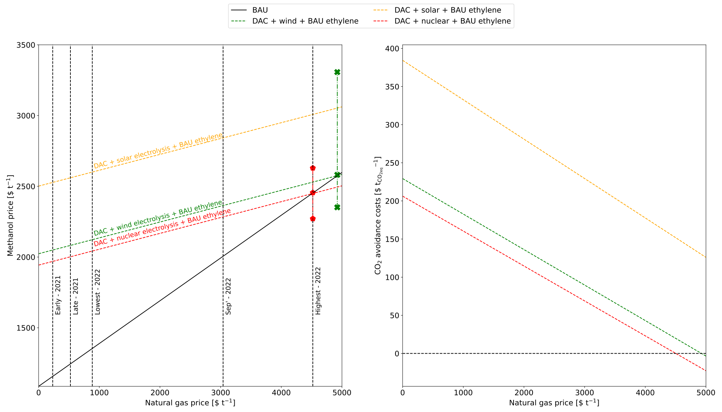

Slide 11
